Slide 1
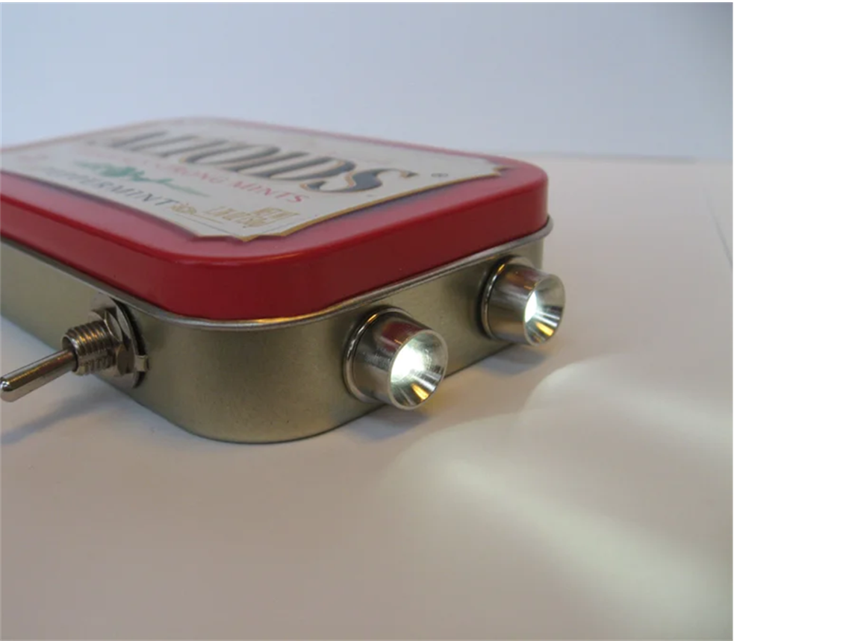
DIY Flashlight Workshop
What are we making?
HINT !
Has Polarity
Uses Ohm's Law
Uses Voltage and Currents
Has a Breadboard
Light-hearted fun ☺
IEEE x SWE Mystery Design

Slide 2
Definitions

Slide 3
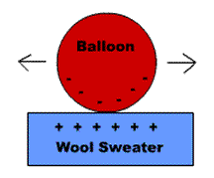
Voltage
“The measure of the amount of charge at one location, relative to another”
Opposite charges attract; Like charges repel
This “push” of the charges trying to repel each other is voltage!
Notes:
Describe LED and components
Direct to diagram (EX: purple for N-type and green for P-type)
Function explanation:
Between the two semiconductors is a barrier to stop the charges from crossing.
The barrier becomes less effective as voltage is increased
As the barrier stops working, charges move across the junction. When a positive and negative charge combine, you get light

Slide 4
LED
Light Emitting Diode
Composed of two semiconductors:
N-type: (Negative charge) is doped with elements (like phosphorus) that have more electrons.
P-type: (Positive charge) is doped with elements (like boron) that have fewer electrons.
P-Type
N-Type
Notes:
Describe LED and components
Direct to diagram (EX: purple for N-type and green for P-type)
Function explanation:
Between the two semiconductors is a barrier to stop the charges from crossing.
The barrier becomes less effective as voltage is increased
As the barrier stops working, charges move across the junction. When a positive and negative charge combine, you get light

Slide 5
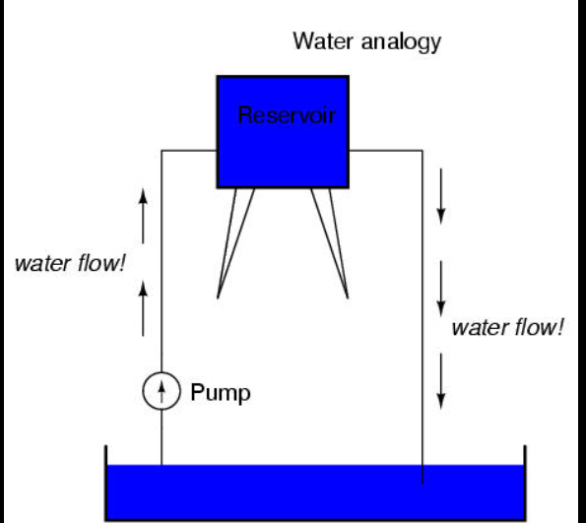
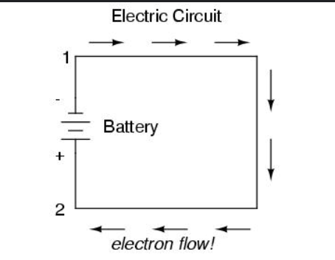
Case Study: Water Flow

Slide 6
What We Are Building
Our LED’s are rated to turn on at 2 ish Volts and 15 ish mA
We have a 3 Volt battery
But 3 Volts > 2 Volts
How can we fix this ?
Notes:
Explain basics of how flashlight components come together (EX: Battery powers LEDs)
Introduce compatibility issue

Slide 7
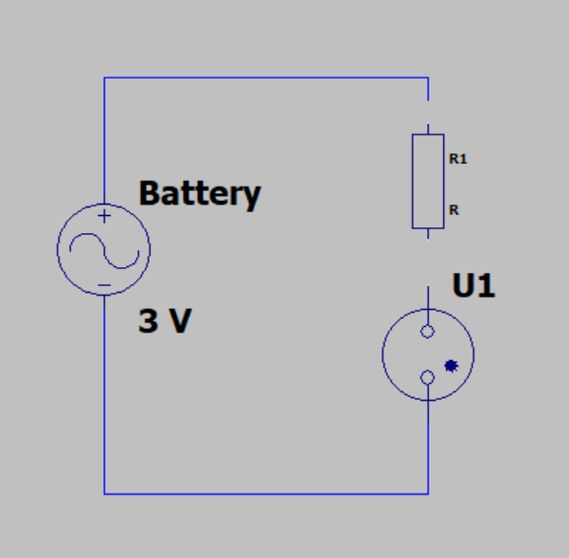
Engineer Our Circuit
? V
3 V
2 V
LED
Notes:
Explain circuit diagram, including how voltage will need to change
Ask how many volts will need to be dropped in “?” to complete circuit

Slide 8
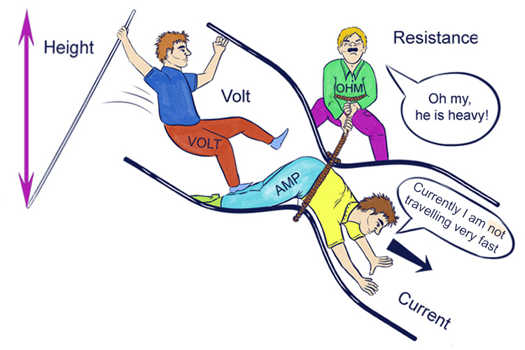
Ohm’s Law
Voltage = Current * Resistance
(1 V )= (15 mA) * R
R =
~70 ohms
Round up to 100 ohms
Notes:
Describe LED and components
Direct to diagram (EX: purple for N-type and green for P-type)
Function explanation:
Between the two semiconductors is a barrier to stop the charges from crossing.
The barrier becomes less effective as voltage is increased
As the barrier stops working, charges move across the junction. When a positive and negative charge combine, you get light

Slide 9
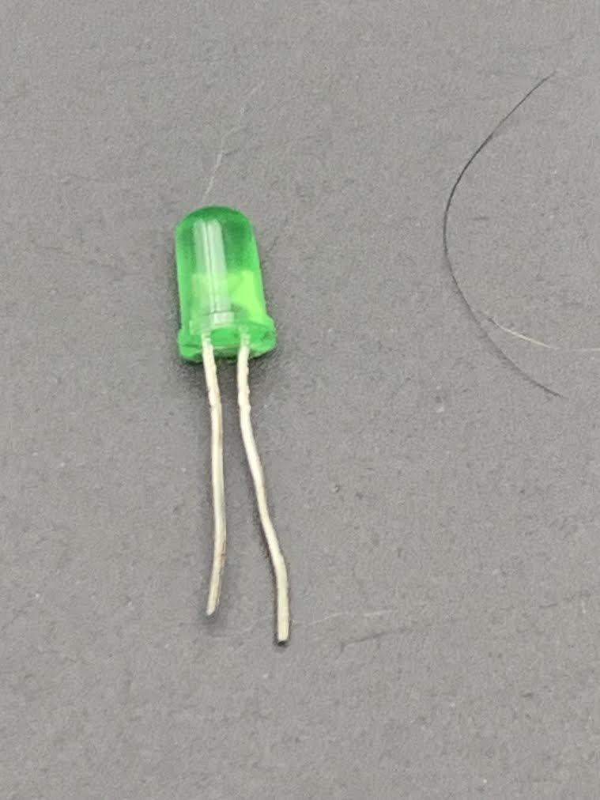
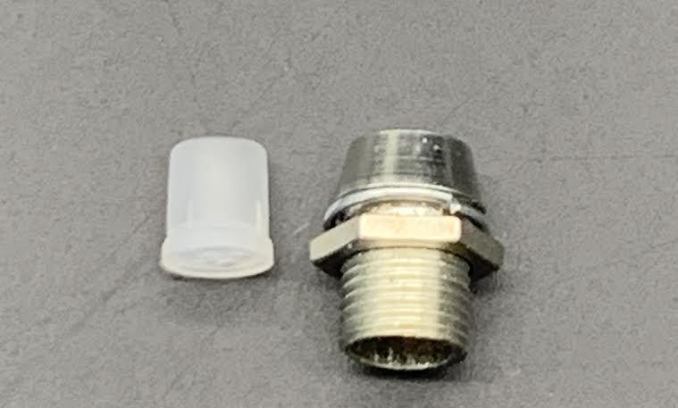
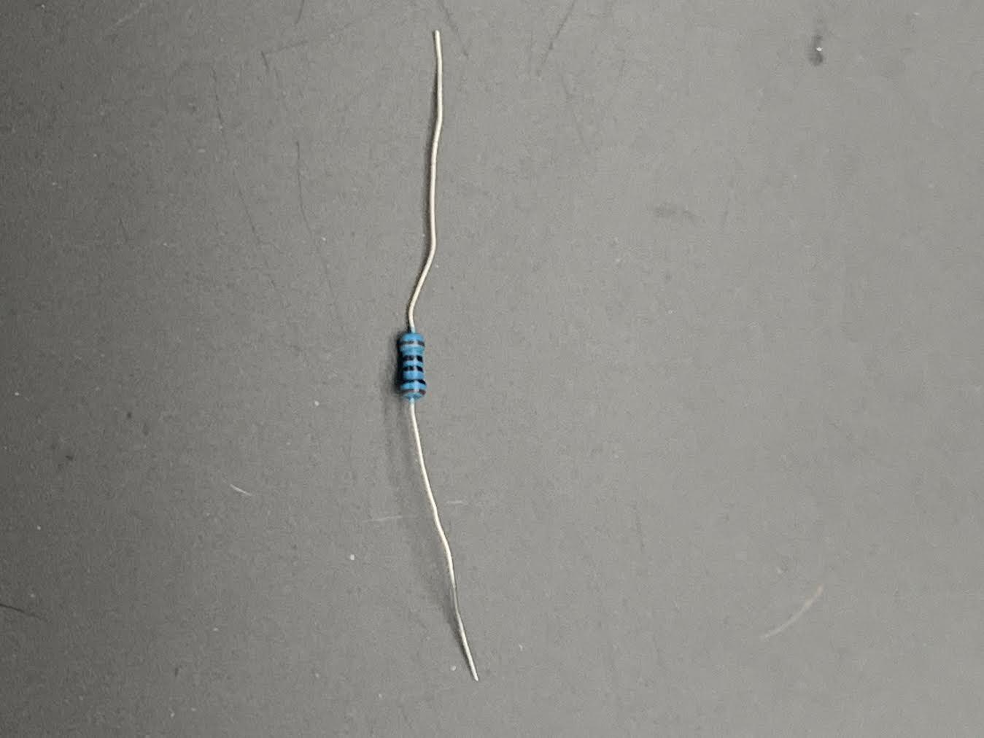
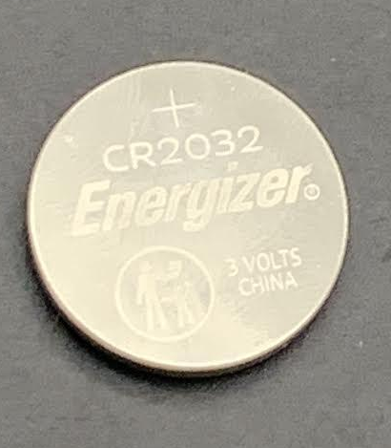
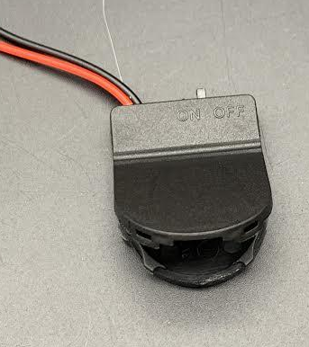
Materials
2x Clear 5mm LEDs - Color of your choice.
2x 5mm LED Holder - Chrome
1x 100 Ohm resistors
1x 3V CR2032 battery and holder
1x Plastic container
Notes:
List materials
Verify all materials are present in boxes

Slide 10
Let’s Make Flashlights!

Slide 11
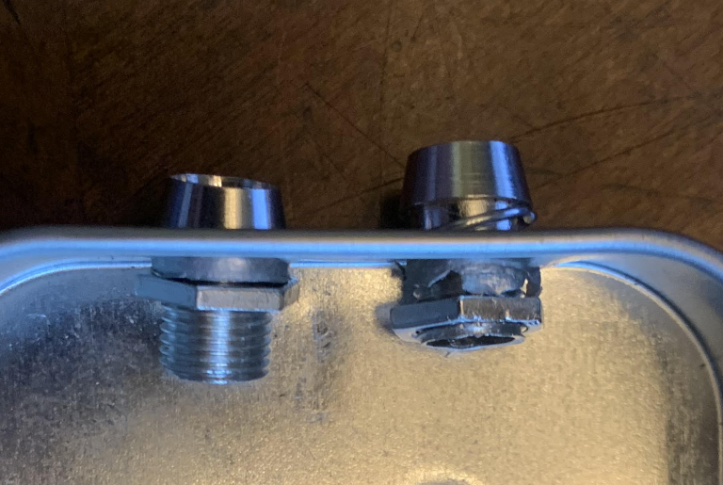
Step 1 – Prepare the container
Screw on LED holders

Slide 12
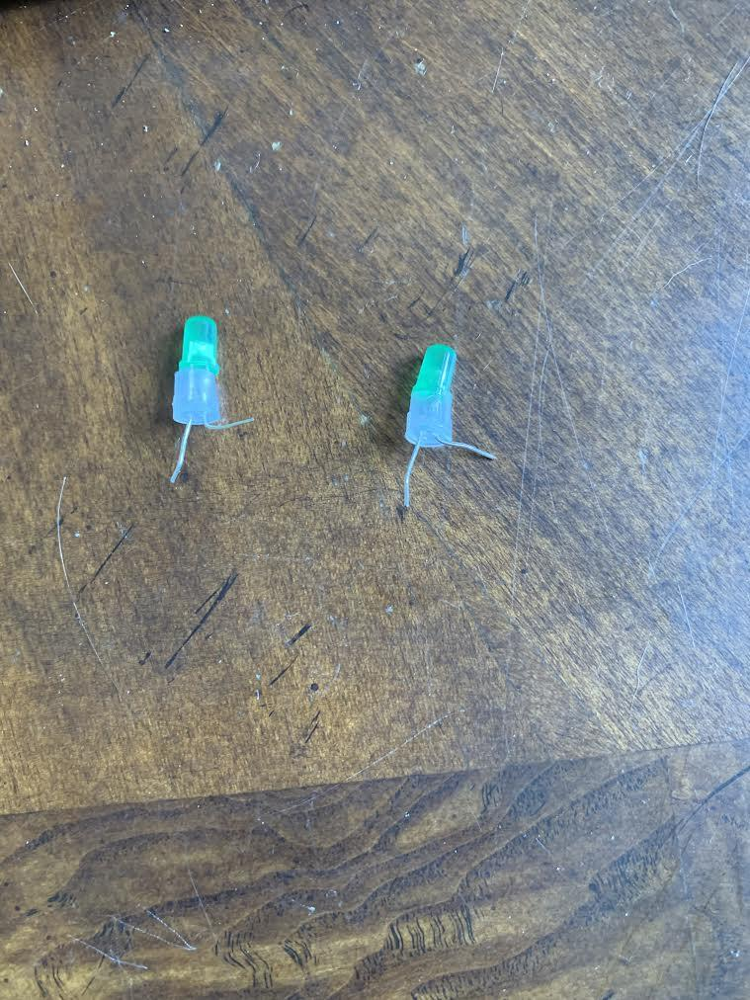
Step 2 – Prepare the LEDs
1. Insert both LED legs through the plastic holder.
2. Pull shorter leg (-) up by 90 degrees (this leg is the negative side of the LED)
Pay attention to which side is negative!

Slide 13
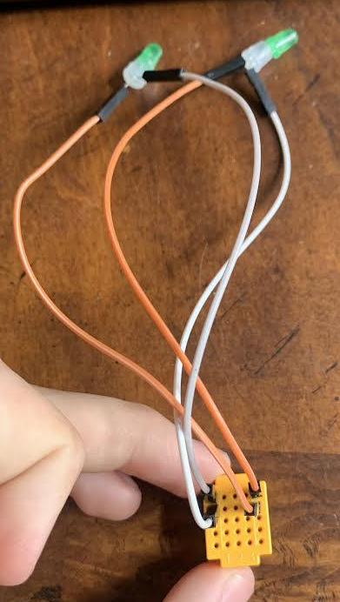
Step 3 – Connect the LEDs
Connect short leg (-) of LED to left column of board.
Connect long leg (+) to the right column of board.
(Important: LEDs only work when electricity flows in the right direction.)
Note: Colors of wire shown might not coordinate with your own.

Slide 14

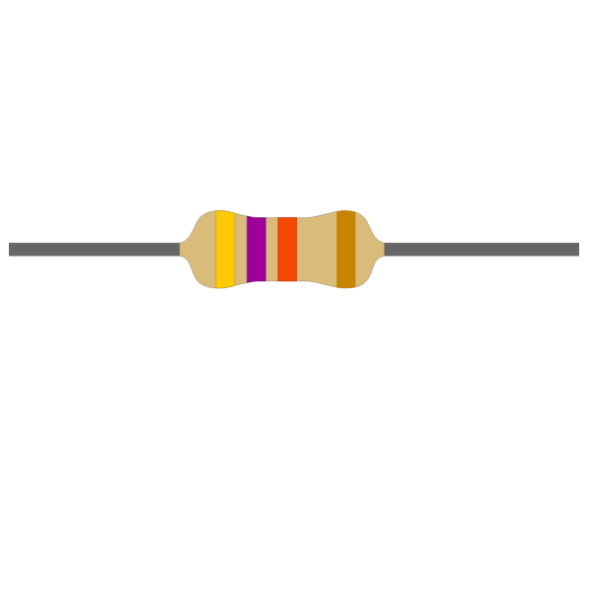
Add in the battery.
Black Leg = Short (-)
Red Leg = Long (+)
And the resistor

Slide 15
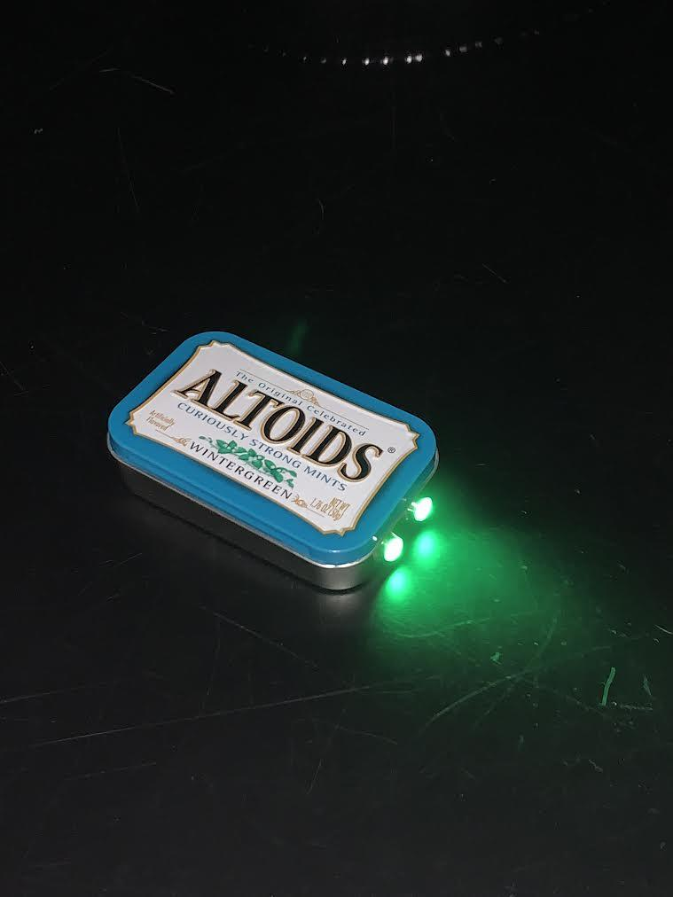
Step 4 – Assemble
Neatly organize your components in a plastic container.
Switch the battery connector
Enjoy your DIY flashlight!

Slide 16
The End!
Congratulations on building your very own flashlight!

Slide 17
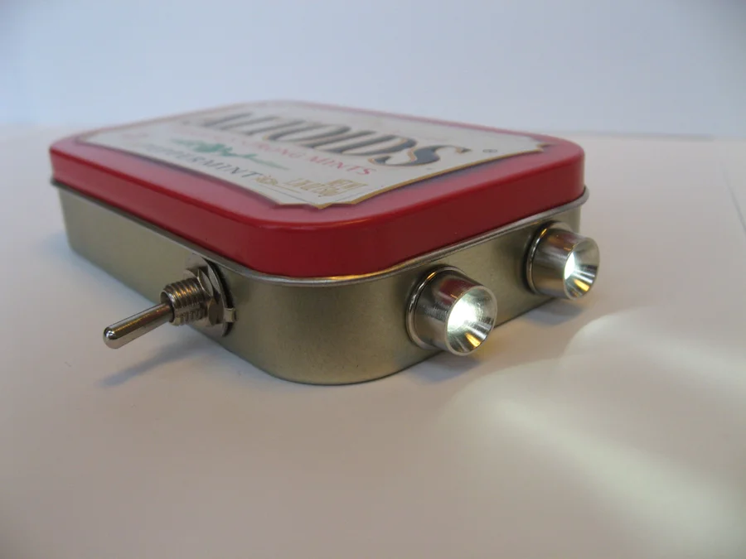
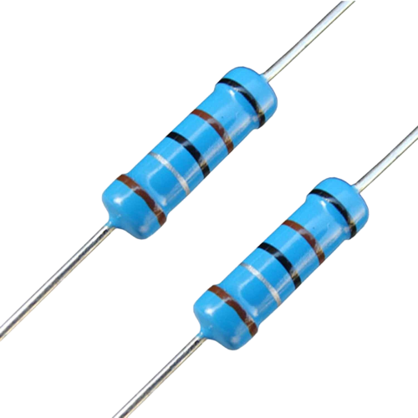
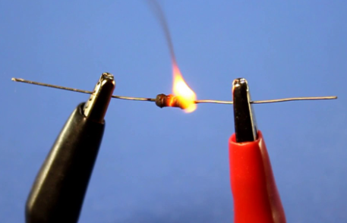
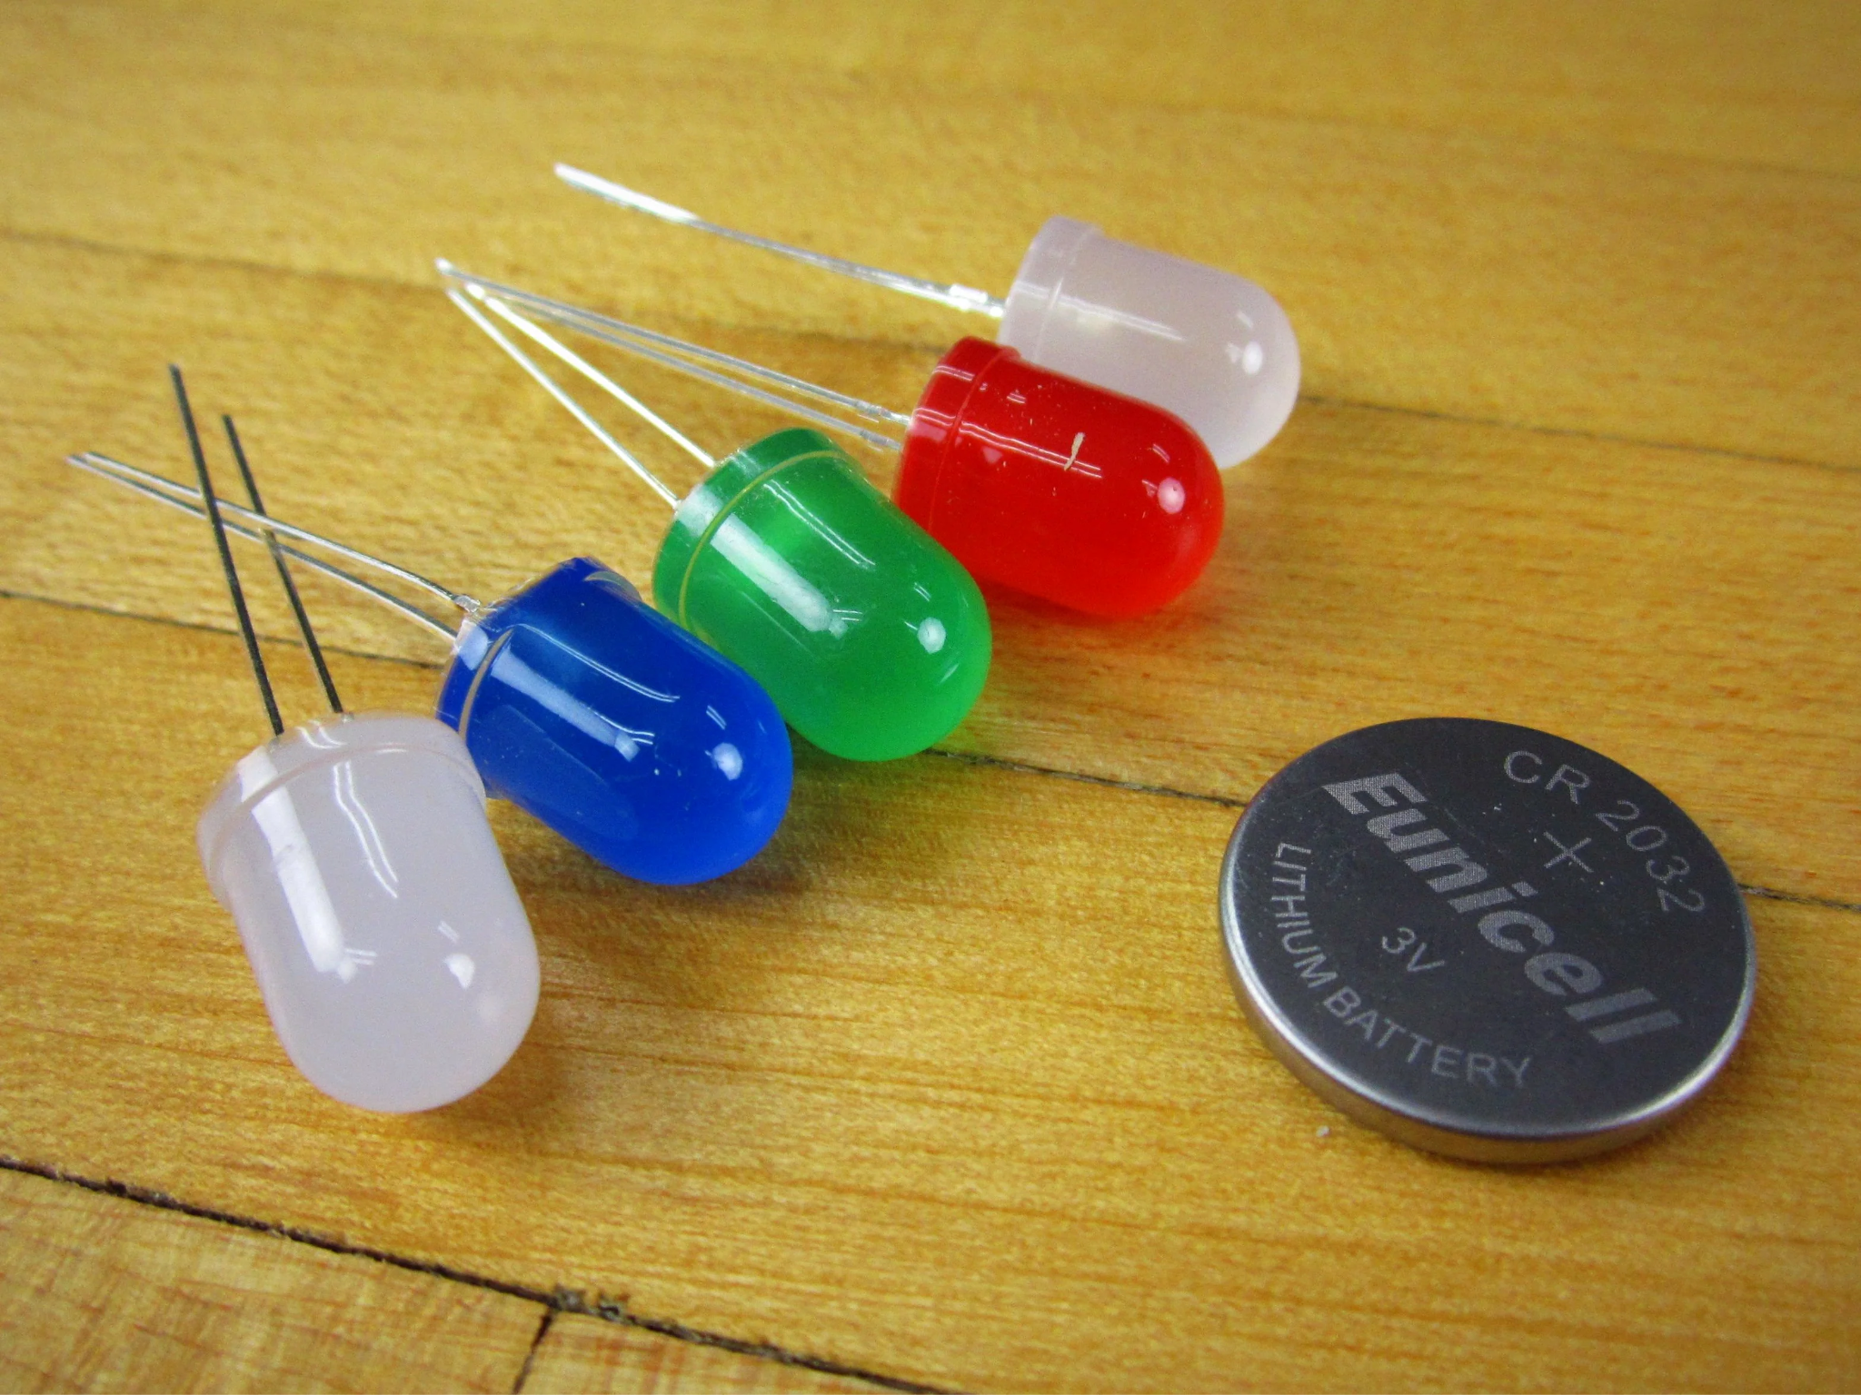
DIY Flashlight Workshop
Notes:
Introduce yourselves
Welcome to workshop!

Slide 18
What Are We Learning Today ?
Basics of Electric Circuits
Polarity
Ohm's Law
Voltage and Current
What is a breadboard and how does it work?
Notes:
State the fundamentals of the workshop
OPTIONAL: Ask if anyone has heard of or used a breadboard before

Slide 19
What is an LED ?
Light Emitting Diode
To make an LED, just 2 materials are needed
N-type semiconductor: Holds positive charges
P-type semiconductor: Holds negative charges
Voltage increase → Weakened barrier → Colliding charges → LIGHT
Notes:
Describe LED and components
Direct to diagram (EX: purple for N-type and green for P-type)
Function explanation:
Between the two semiconductors is a barrier to stop the charges from crossing.
The barrier becomes less effective as voltage is increased
As the barrier stops working, charges move across the junction. When a positive and negative charge combine, you get light

Slide 20
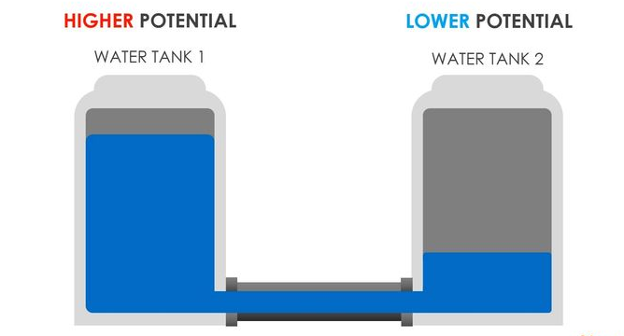
But then what is voltage ?
Voltage is the “measure of the amount of charge at one location, relative to another”
Like charges (charges of the same kind) repel each other
This “push” of the charges trying to repel each other is voltage
Notes:
Define and explain voltage
Refer to charge attraction to relate explanation to primary education concepts
Left Image: Higher potential wants to move to lower potential, potential difference signifying voltage
Right Image: Balloon (negative) spreads to make as much contact with wool surface (positive) as possible, showing how voltage incentivizes electrical change

Slide 21
What We Are Building
Our LED’s are rated to turn on at 2 ish Volts and 15 ish mA
We have a 3 Volt battery
But these don’t match !!!
How can we fix this ?
Notes:
Explain basics of how flashlight components come together (EX: Battery powers LEDs)
Introduce compatibility issue

Slide 22
Ohm’s Law
Voltage = Current * Resistance
~ 1 V = ~15mA * R
R = ~70 ohms
Round up to 100 ohms
Notes:
Explain Ohm’s law
Use formula to determine resistance needed for voltage drop

Slide 23
Materials
Parts:
2x Clear 5mm LEDs - Color of your choice.
2x 5mm LED Holder - Chrome
1x 100 Ohm resistors
1x 3V CR2032 battery and holder
1x Plastic container
Notes:
List materials
Verify all materials are present in boxes

Slide 24
Step by Step!

Slide 25
Step 1
Prepare your container:
1. Screw on LED holders

Slide 26
Step 2
Prepare your LED’s carefully:
1. Insert both LED legs through the plastic holder.
2. Pull shorter leg up by 90 degrees (this leg is the negative side of the LED)

Slide 27
Step 3
Connect LED’s
Connect short leg of LED to left column of board.
Connect long leg to the right column of board.
(This step is crucial as LEDs only work
when electricity flows in the right
direction.)
*Please note: Colors of wire shown might not coordinate with your own.

Slide 28
Step 4
Assemble into plastic container:
Organize your components neatly and switch the battery connector
(You should have a functioning flashlight now!)

Slide 29
The End!
Congratulations on building your very own flashlight!

